Slide 1
Diabetic data Analysis
Dataset
Reading datasets from Diabetic.csv
Variables
X =Age
df.head()
df.tail()
df.describe()
Y=Pregnancies
Z=Outcome
Correlation Matrix
Visualise
3 Variables
Histograms
Glucose
2Age
3Age
If

Slide 2
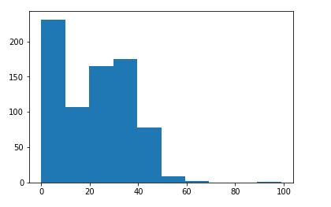
Univarable Histogram

Slide 3
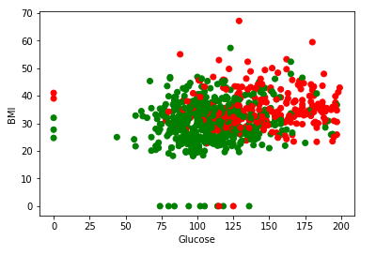
Scatterplot for X and Y variable

Slide 4
https://github.com/Ranjan4mh/assigment2_module1.git
Source code is available at the Above github link

